Slide 1


Slide 2

Developer Assistant
Submitted by:
Name | Roll No | Branch
Sarthak Jain | R171218088 | CSE-DevOps
Siddharth Chopra | R178218045 | CSE-MAD
Manvi Kulshrestha | R178218022 | CSE-MAD
Under the guidance of
Dr. Hitesh Kumar Sharma
Associate Professor
Department of Cybernetics,
School of Computer Science

Slide 3
INTRODUCTION
In almost all cases, the command line is much faster and easier to use for an expert, but not for a beginner. For beginners, this is synonymous with learning a new language to speak, and if you do not use it you lose it. This is because of its learning curve to remember the commands in which accuracy has the utmost importance. Like even if there is a spelling error, a command will fail. Also, if an instruction is mistyped, people often need to start from scratch.
Typing the wrong commands, could accidentally delete files or close the program before you saved your work. This is considered to be the main disadvantage of using a command line that is strictly text-based.^{[4]} Also, some things are hard or annoying to do on the command line, like things that require a lot of typing, such as long file names, that too without minimal cut/paste support.

Slide 4

PROBLEM STATEMENT
For beginners, it is hard to memorize the CLI commands as there are a large number of commands which need to be learned for various applications. Also, if there is a spelling mistake in the command then it will not respond or fail.
If a user can mistype an instruction, it is often necessary to start from scratch again.
Also, if we need to work simultaneously with different services like AWS, Docker, etc. We need to run different applications which are time consuming.

Slide 5

OBJECTIVES
Our aim is to develop an assistant that works upon voice or text based commands which helps the developer to upload/configure or launch the services like AWS, docker, GitHub, Git, SQL and other applications in one go.

Slide 6
WORK DONE SO FAR
We have prepared the menu for controlling the services via command line so far. For now, we will be controlling or using these services:
Linux
Hadoop
Aws
Docker

Slide 7
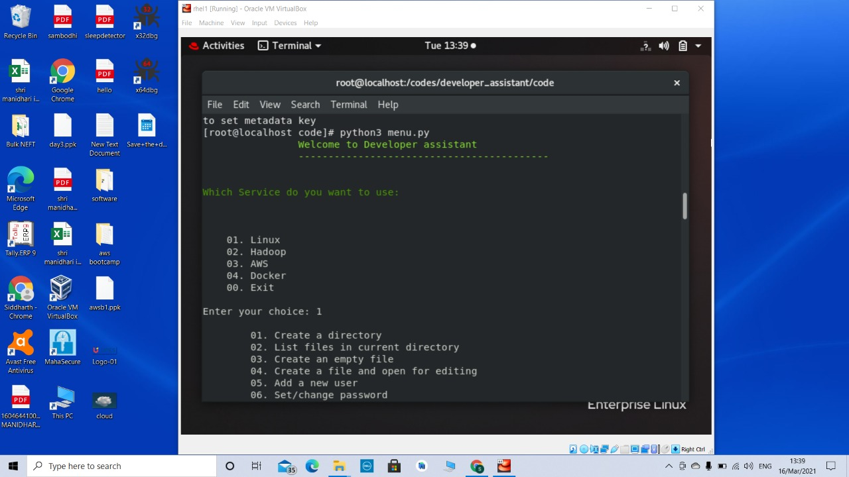
OUTPUTS

Slide 8
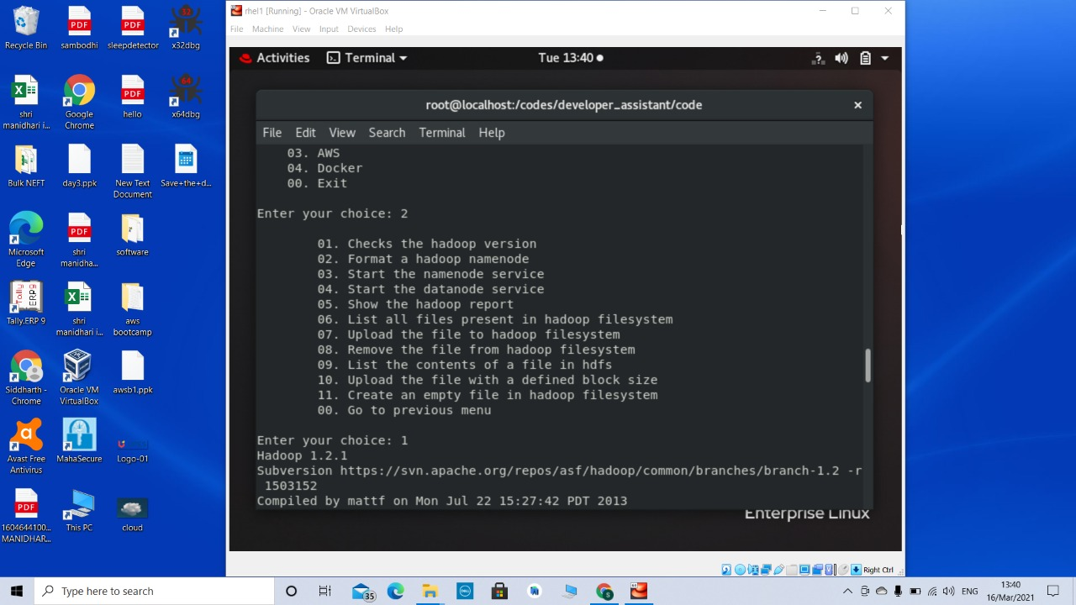

Slide 9
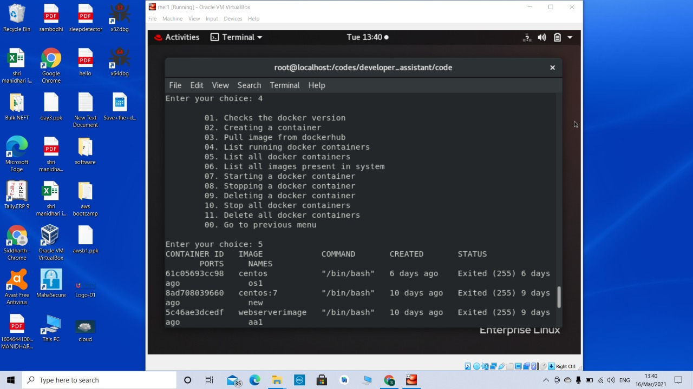

Slide 10
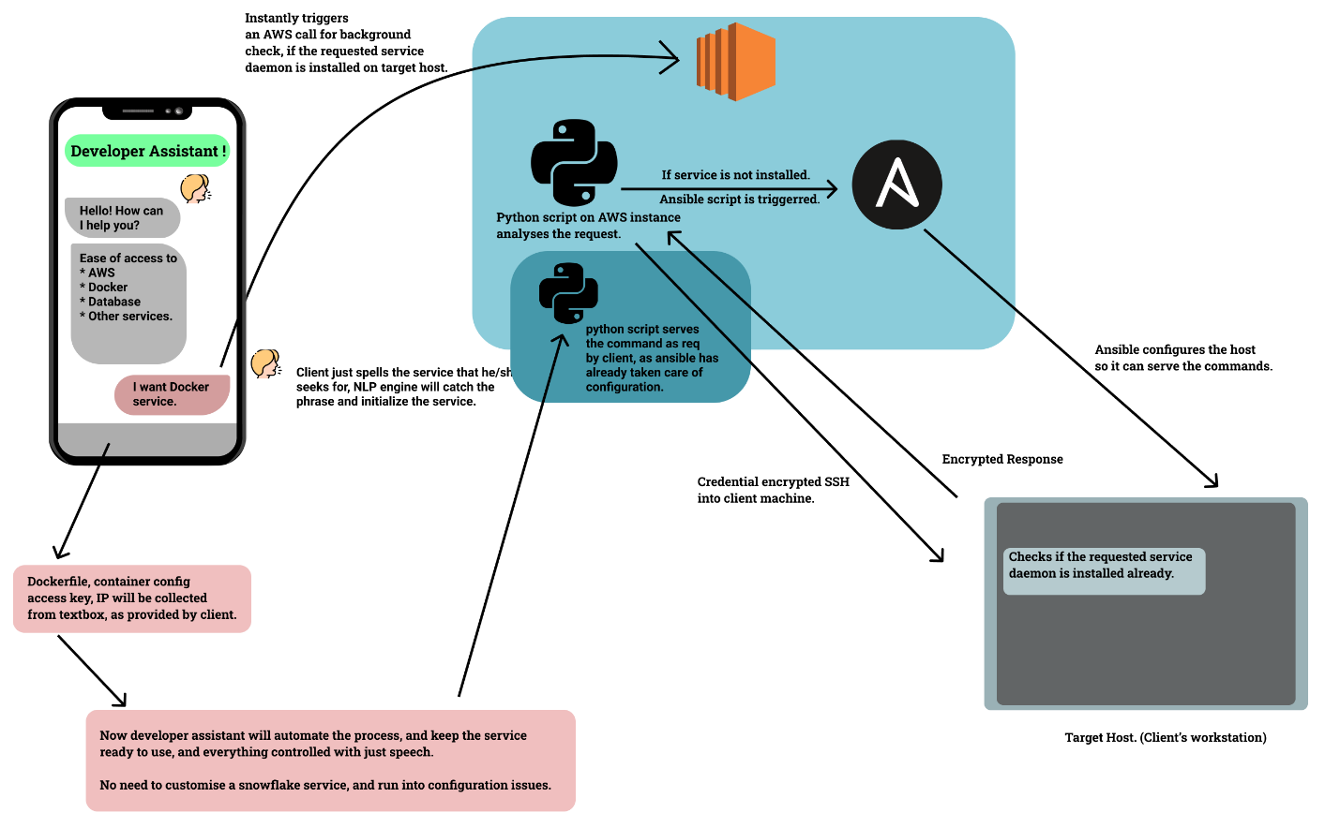
DATA FLOW DIAGRAM

Slide 11
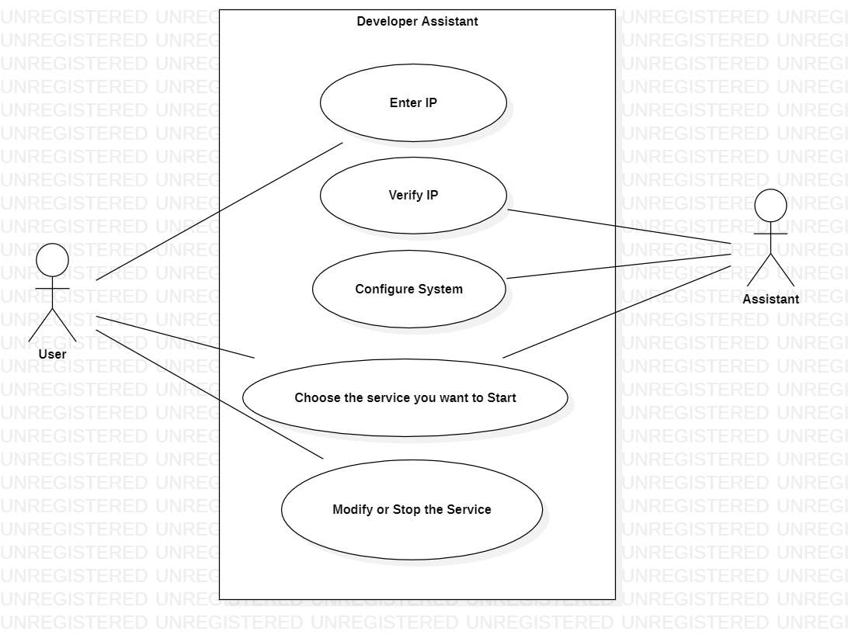
USE CASE DIAGRAM

Slide 12
THANK YOU

